Slide 1
Software Engineering and Architecture
Hyper Text Transfer Protocol
HTTP

Slide 2
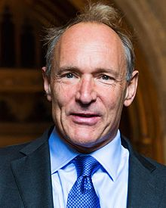
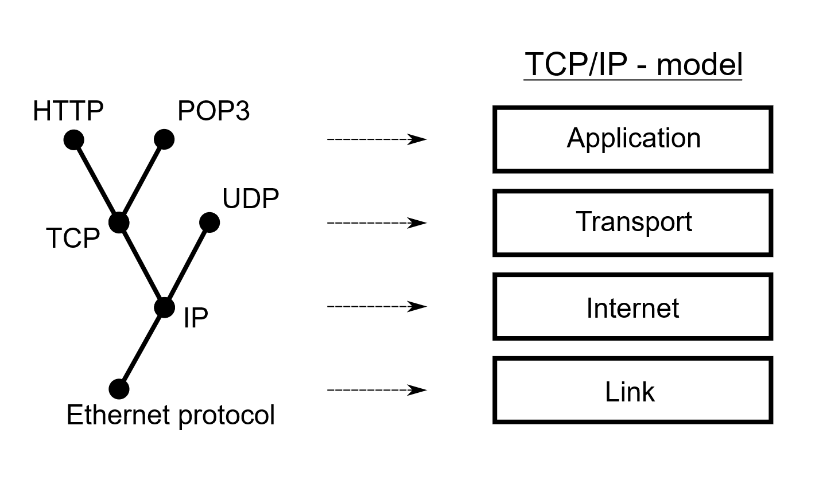
WWW
Tim Berners-Lee approx. 1989 - 1990
Task: Sharing research documents at CERN
Solution:
Hypertext protocol over TCP/IP for retrieving documents
Actually, a very simple text based format

Slide 3
Just a Note
Web, world wide web, HTML, HTTP may seem like one big jumble but they are distinct concepts though they were developed in parallel. They have different roles to play.
HTML: Hypertext Markup Language is a dataformat, useful for visual formatting of text document containing images and references (hyperlinks) to other documents.
HTTP: Hypertext Transfer Protocol is an application protocol for distributed information systems. (Actually not related to ‘hypertext’ ☺)
WWW: The internet-based TCP/IP system made that used HTML+HTTP to share documents at CERN, and later – quite a few other places ☺

Slide 4
Request-Reply Protocol
As ‘I want to view this HTML document’ is essentially a synchronous task…
No point in reading a document that is not loaded yet…
HTTP adhere to the request-reply protocol
My browser sends a request to a web server and blocks until…
… the server has returned a document, after which…
My browser renders the text on my screen…
HTTP thus must define
Format of request. Format of reply.

Slide 5
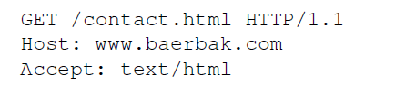
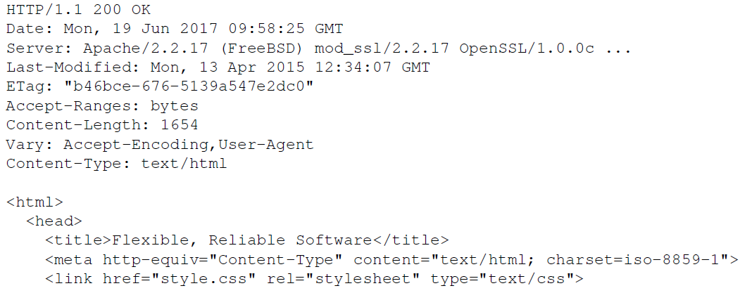
“Marshalling” - Message Format
Text format !
Request line
Verb resource HTTP version
Header key-values
Empty line
(contents)
Reply line
Status line
HTTP codes
Header fields
Empty line
Message body

Slide 6
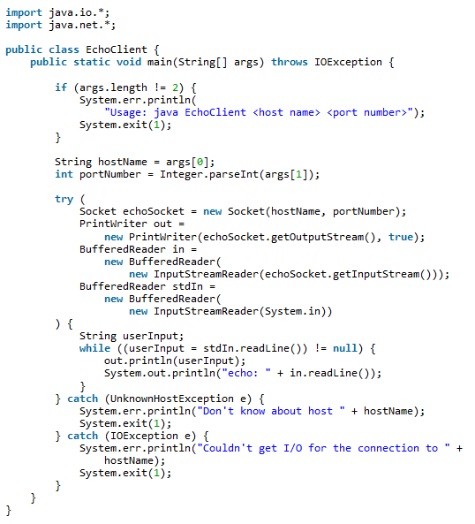
Write your Own Web Client
Exercise in class:
Write a web client
“java webclient www.baerbak.com”
Notes:
What should be altered to get a web page?

Slide 7
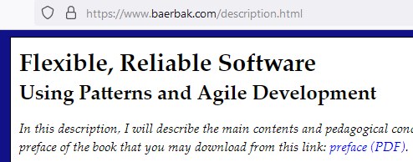
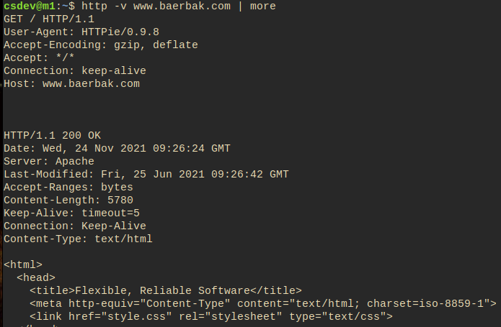
Clients
The most well-known clients are browsers
Developers often use commandline browsers instead
curl (= see-url)
httpie

Slide 8
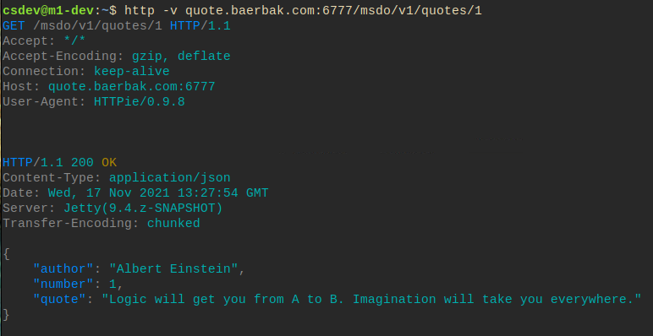
Ala…
Testing the quote service for my ‘MicroService’ course

Slide 9
URI / URL
HTTP is about resources = named data/information
Naming the resources follows a strict format
URI: Uniform Resource Identifier
URL = URI in which resource location and means are defined
http://www.baerbak.com/contact.html
http://localhost:4567/bin
Exercise: Identify the parts of the URI

Slide 10
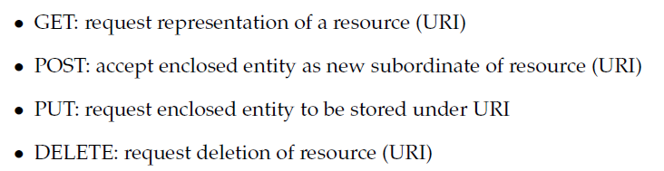
HTTP Verbs
Http version 1.1. defines 4 verbs (ok, some more…)
… which are basically the database verbs
CRUD Create, Read, Update, Delete
These form the core of the REST architectural style…

Slide 11
GET
GET is the ‘first and original verb’, and the one most traffic uses on WWW
Browing web pages
Or even make searches on the web server
GET is idempotent
Call once or 100 times, the output is the same
It is an ‘accessor’ / ‘query’ method!

Slide 12
POST
POST means ‘create’
That is, create new resources/information on the server
It is a ‘mutator’/’command’ method
Consider ‘paystation.addPayment(5);’
Command pattern: Convert method call to an object
Now, consider that ‘paystation’ is on the server side
POST allows us to create a command object
POST /paystation HTTP/1.1
Body { method: ‘addPayment’, argument: ‘5’ }

Slide 13
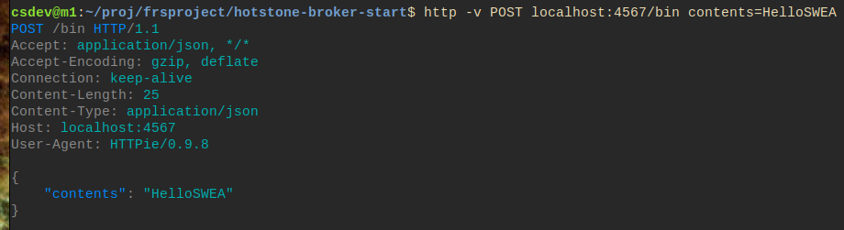
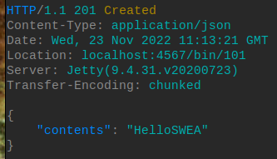
POST Example
Example: A ‘Pastebin’ server accepting contents on its /bin path. Contents encoded as JSON.
Reply:
Notes:
Meta: broker/pastebin – gradle

Slide 14
PUT, DELETE
... Will we return to later, when we discuss REST...
PUT = update existing information
DELETE = (guess ☺)
CRUD = Create, Read, Update, Delete
HTTP is basically a database protocol on shared resources ☺

Slide 15
Failures in Distribution
A lot of things can and will go wrong in distributed systems
The server has crashed
The network has crashed
Server does not understand what you talk about
You do not have the proper authorization
We normally use exceptions to signal failures
But – does not work over networks ☹
The old way: Error codes

Slide 16
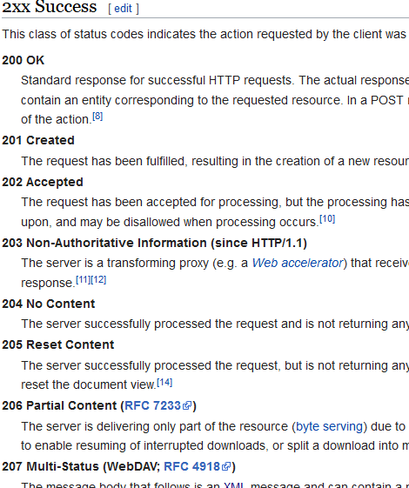
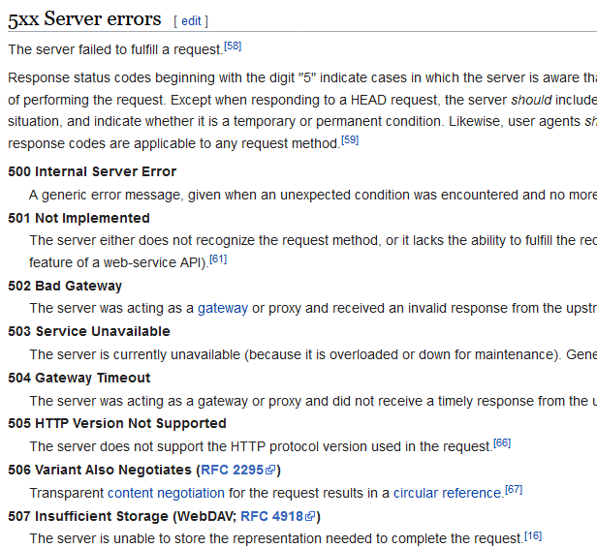
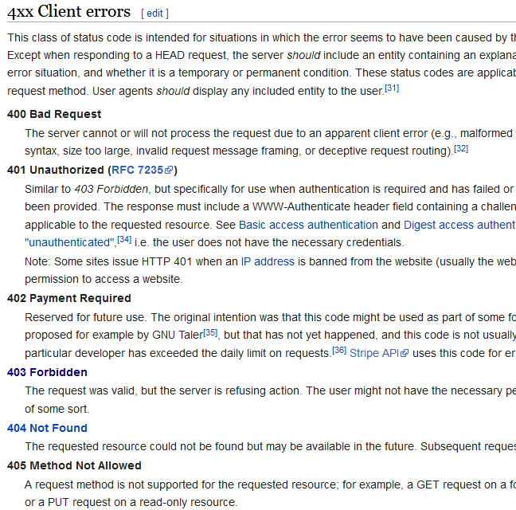
HTTP Status Codes
Well defined vocabulary of error codes! See Wikipedia

Slide 17

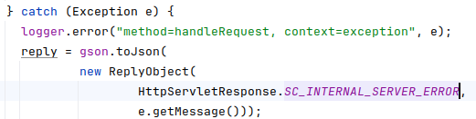
I have reused these in Broker
You have probably already used these in Invoker code
And if you have added exception handling from TeleMed

Slide 18

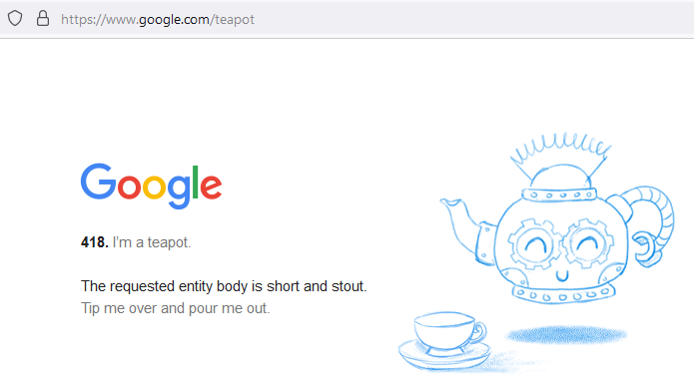
Fun Fact
Code 418

Slide 19
Media Types
The requestor and the replier need to agree on the dataformat that data is exchanged in
Media types, defined by IANA
Internet Assigned Number Authority
Well known types
text/html: HTML formatted text
image/gif: Image in the GIF format
application/xml: XML format
application/json: JSON format
I want HTML, please

Slide 20
Summary
HTTP is a protocol = interaction requirements
Defining the contract between client and server roles
Basically just exchange of text messages
Defined by a format ala
Verb line (request) Status line (replies)
Headers – (key,value) pairs
Empty line
“body” = the core contents of the message
Verbs are GET, POST, PUT, DELETE
Media types define data format of the ‘body’
Status codes defines a vocabulary of error types
200 OK and 404 Not Found

